Slide 1

TEST DRIVEN DEVELOPMENT

Slide 2
WHAT IS TDD
A programming practice that instructs developers to write new CODE ONLY IF AN AUTOMATION TEST HAS FAILED.
a development technique where you must first write a test that fails before you write new functional code.

Slide 3
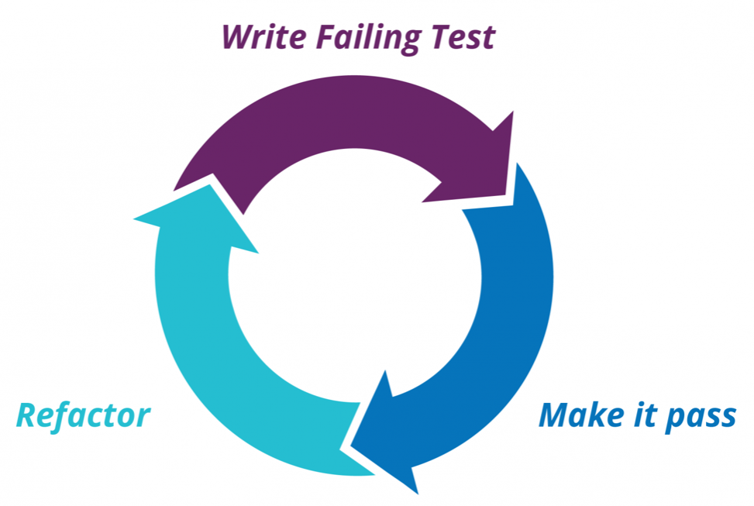
TDD PROCESS
THINK
Write a Test
Check test fails
Write Code
Check all tests are ok
Refactoring
Run unit tests
Check in the code

Slide 4
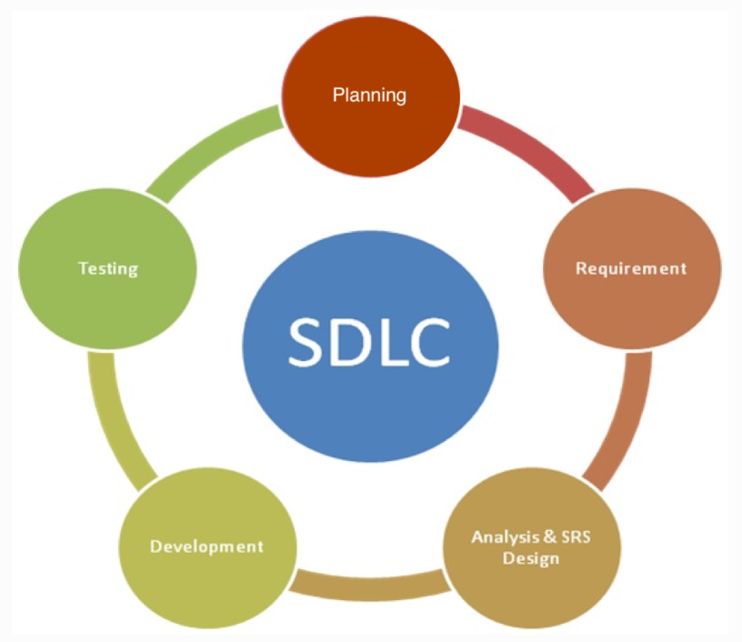
TRADITIONAL SOFTWARE PROCESS
DESIGN
IMPLEMENT
TEST
MAINTAINENCE

Slide 5
ADVantages
Writing the tests first requires you to really consider what do you want from the code.
You receive fast feedback.
TDD reduces time spent on rework.
You are able to identify the errors and problems quickly.
TDD tells you whether your last change (or refactoring) broke previously working code.

Slide 6
TOOLS
Cpputest – xUnit framework written in C++ used for c/c++
csUnit -(.Net)
Cunit – used in c
DUnit (Delphi) –UT framework for pascal
Googletest – UT library for C++ programming.
HTMLUnit – written in java but used for html
HTTPUnit - used for testing of websites
Jmock - used in java to define mock objects.
Junit - important UT framework for java
Moq – used in c#
PHPUnit – used in php

Slide 7

THANK YOU!!

